Slide 1
The cafeteria meal planner
Analysis and design
09.XII.2022

Slide 2
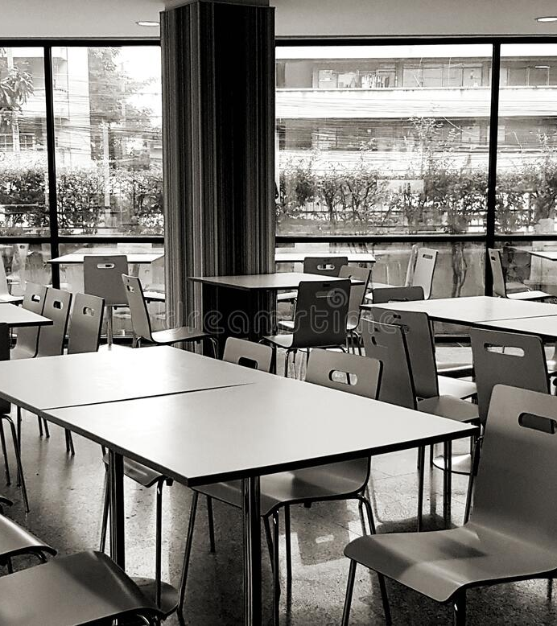
Agenda
GENERAL PRESENTATION
THEORETICAL FUNDAMENTALS
IT TECHNOLOGY
ACTORS
USE CASES
SYSTEM ARCHITECTURE
DESIGN
OPERATION MODE
PORTABILITY

Slide 3

General presentation
WHAT IS “THE CAFETERIA MEAL PLANNER”
The project called “The Cafeteria Meal Planner” is a web application meant to bring together people who look to eat at cafeterias and cafeteria managers who want to get their menus to the world as quick and as easy as possible.

Slide 4
Theoretical Fundamentals
Databases
Object Oriented Programming
Full Stack Application
Http communication
Backend and Frontend

Slide 5
IT TECHNOLOGIES
React.js
H2 Database
Java and Spring Boot

Slide 6
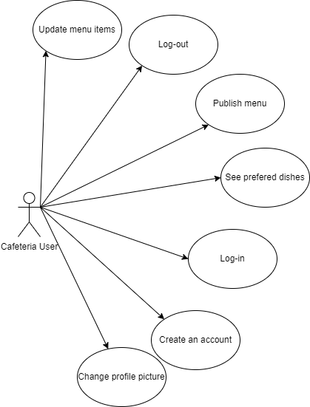
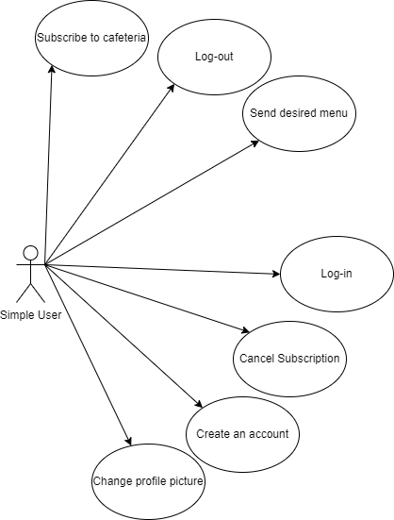
Actors and use cases

Slide 7
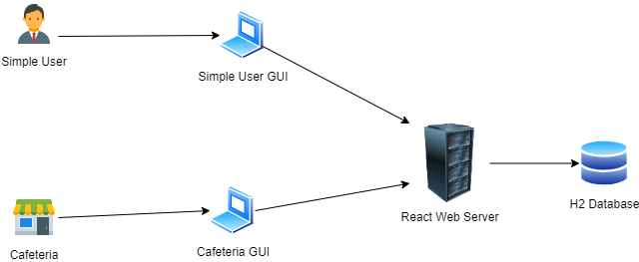
System architecture

Slide 8
Design
Package diagram
This is the basic architecture for any well behaving web application. This way we can safely aim for low coupling and high coherence. Also, object oriented principles are conveyed since there is a component taking care of certain jobs, they are not all performed by one huge, messy package. Security also is enhanced thanks to this way of organizing packages.

Slide 9
Design
Activity diagram
Activity for changing the profile picture

Slide 10
Design
Activity diagram
Activity for creating an account

Slide 11
Design
Activity diagram
Activity for logging in.

Slide 12
Design
Activity diagram
Activity for logging out.

Slide 13
Design
Activity diagram
Activity for updating the menu item.

Slide 14
Design
Activity diagram
Activity for publishing the menu.

Slide 15
Design
Activity diagram
Activity for sending the desired menu items.

Slide 16
Design
Activity diagram
Activity for sending the subscribing and unsubscribing to cafeterias.

Slide 17
Design
Activity diagram
Activity for viewing the desired dishes.

Slide 18
Design
Activity diagram
Activity for viewing today’s menu.

Slide 19
Design
Activity diagram
Activity for viewing tomorrow’s options.

Slide 20
Design
Deployment diagram
The database is held in an open source server from Java and also kept locally in a special storage file.
With the database communicates the main server sending commands and receiving data from the database.
The GUI is in a web server connected to the backend files, sending requests and receiving responses.
And the user accesses the web server from its own PC.

Slide 21
Design
Deployment diagram
In the deployment diagram it is easiest to see how the base components interact: the client uses the pc to access the GUI and make requests through it to turn on functionalities in the back end which makes calls to the database.

Slide 22
Design
Database diagram
The database obeys the normal forms separating in a good manner information that do not relate with each other. Inheritance is an important pillar in this database’s design in the Cafeteria User -> USER <- Simple User pair. It is also easy noticeable that many-to-many relationships have been solved by adding extra tables such as “simple_user_cafeteria_subscriptions” and “simple_user_selected_items” or “menu_items_in_menu”.

Slide 23
Design
Class diagram
Class diagram is a complex diagram presenting in an easy to follow manner the way in which the jobs are separated in classes. So the controller classes, for example, do not take care of the jobs of the service classes and rather create a dependency to those classes to request them to perform their job.

Slide 24
Design
Object diagram
The object diagram also helps in understanding the execution process of the application and the communication between objects. The http requests is received by the controller, which then calls the service to perform a certain job, which calls for the repository class’s abilities to perform actions on the database using the models to which the entities have been mapped. A basic example of how http requests are solved in the backend.

Slide 25
Design
Object diagram
The object diagram also helps in understanding the execution process of the application and the communication between objects. The http requests is received by the controller, which then calls the service to perform a certain job, which calls for the repository class’s abilities to perform actions on the database using the models to which the entities have been mapped. A basic example of how http requests are solved in the backend.

Slide 26
Design
Object diagram
The object diagram also helps in understanding the execution process of the application and the communication between objects. The http requests is received by the controller, which then calls the service to perform a certain job, which calls for the repository class’s abilities to perform actions on the database using the models to which the entities have been mapped. A basic example of how http requests are solved in the backend.

Slide 27
Design
Sequence Diagram
Sequence Diagram shows the flow of commands when the user initiates the flow.
Cafeteria setting the menu for the next day.

Slide 28
Design
Sequence Diagram
Sequence Diagram shows the flow of commands when the user initiates the flow.
Simple user creates an account.

Slide 29
Design
Sequence Diagram
Sequence Diagram shows the flow of commands when the user initiates the flow.
Simple user sends the desired dishes to the cafeteria.

Slide 30
Design
Component diagram
The component diagram shows the interactions between the components of the application.

Slide 31
Design
State diagram
The state transition diagram is basically a map of the application, showing how the transition between states is performed.
This one is for the Cafeteria.

Slide 32
Design
State diagram
The state transition diagram is basically a map of the application, showing how the transition between states is performed.
This one is for the Simple User.

Slide 33
Design
State transition diagram
The state transition diagram goes even deeper in the key steps of performing operations in order to move from one state to another.

Slide 34
Design
State transition diagram
The state transition diagram goes even deeper in the key steps of performing operations in order to move from one state to another.

Slide 35
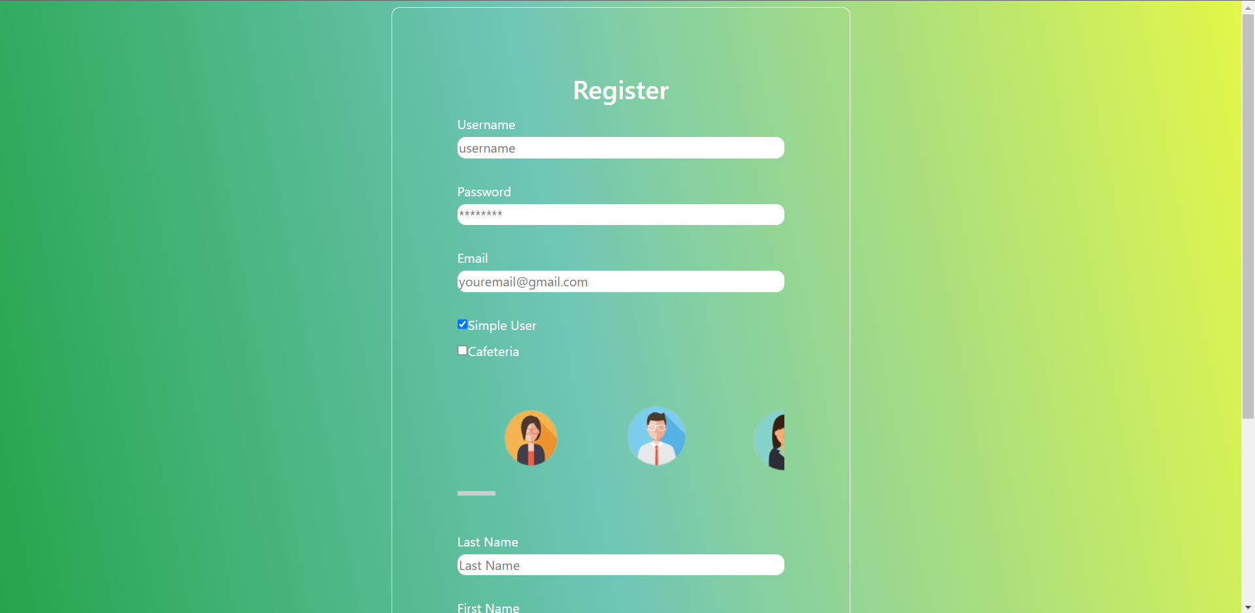
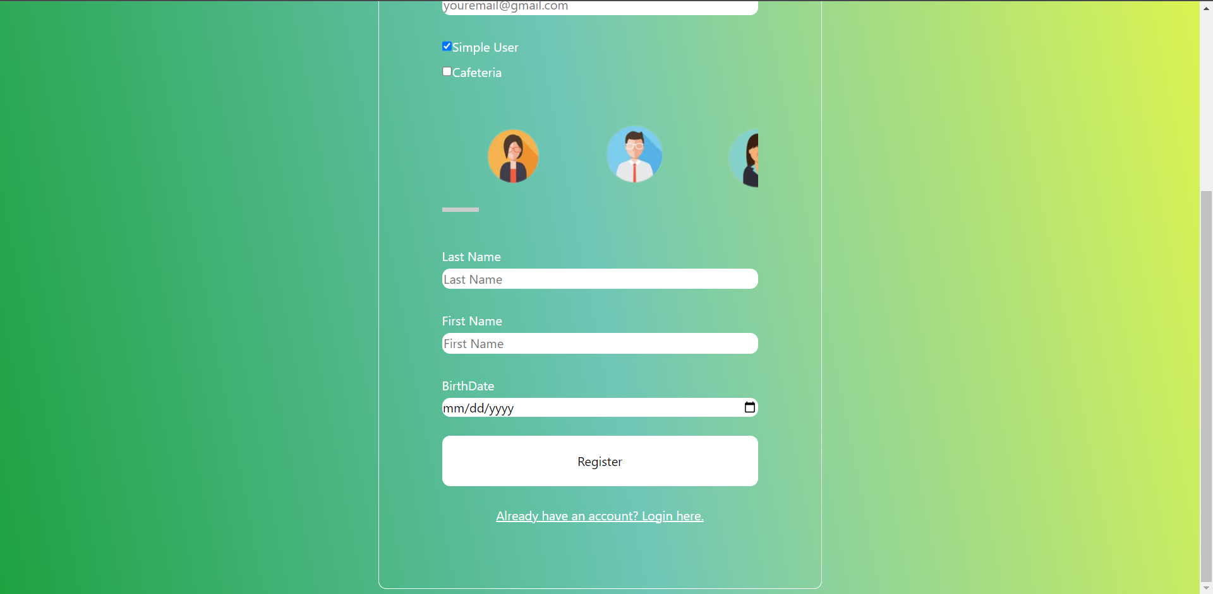
Operation mode
To register, the user must fill the fields. When selecting the type of user: simple or cafeteria, the characteristic fields will appear. When done, the user will click on “Register”.

Slide 36
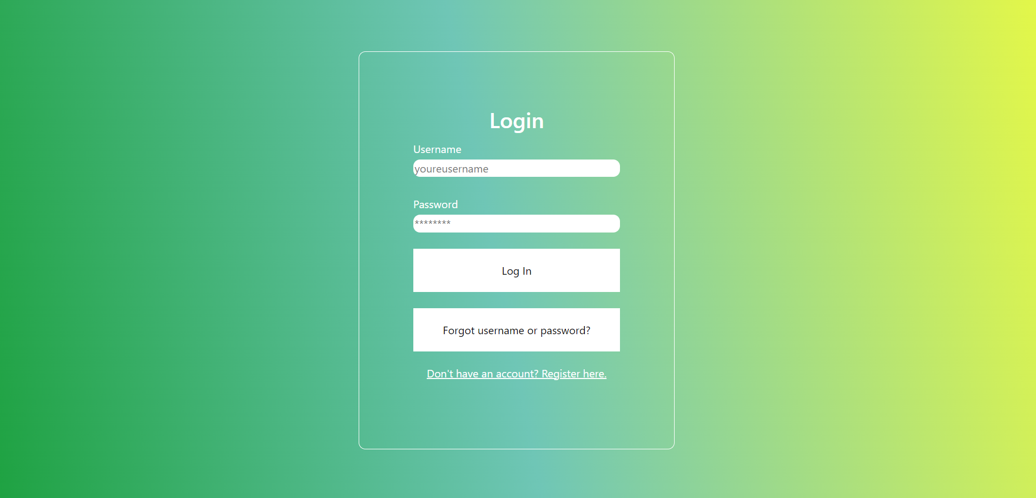
Operation mode
To login, the user enters the credentials and presses the “Log In” button. If credentials are correct, the User GUI will open up.

Slide 37
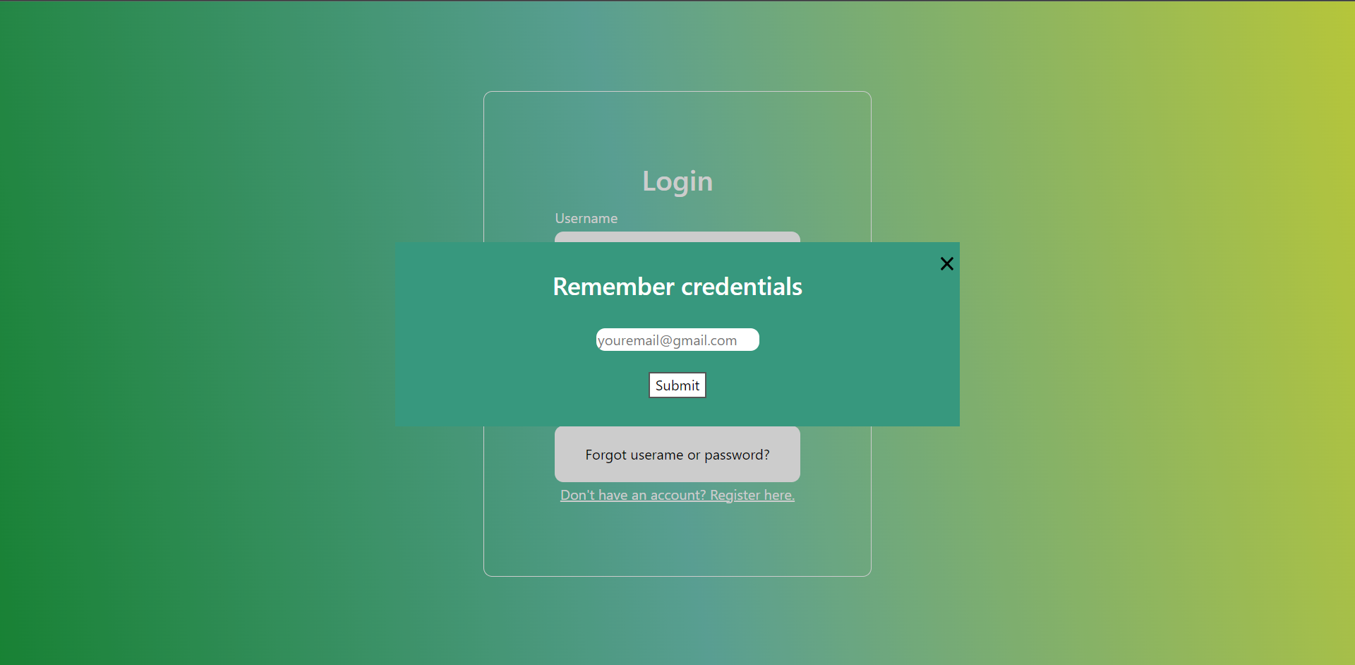
OPERATION MODE
This appears when the user forgets its credentials.

Slide 38
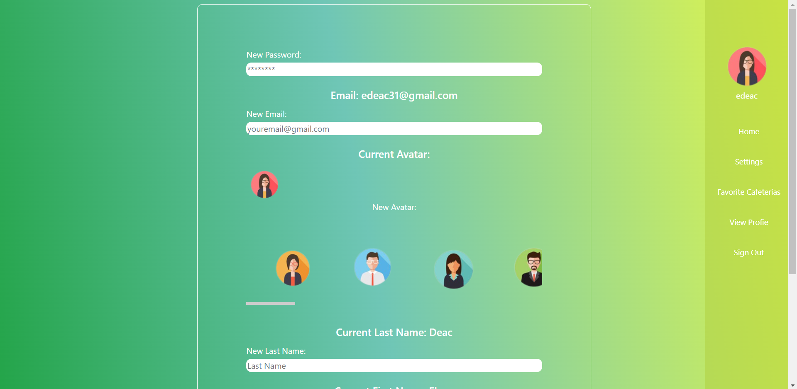
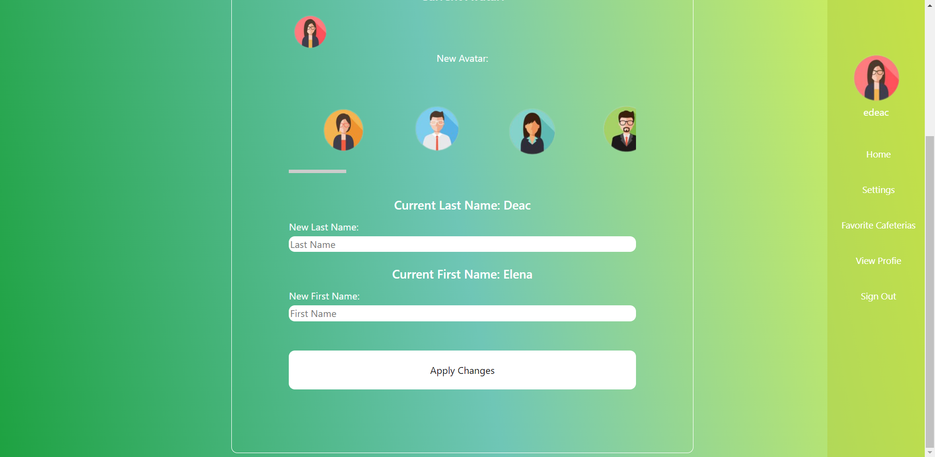
Operation mode
This is what appears when the user enters in the Settings page.

Slide 39
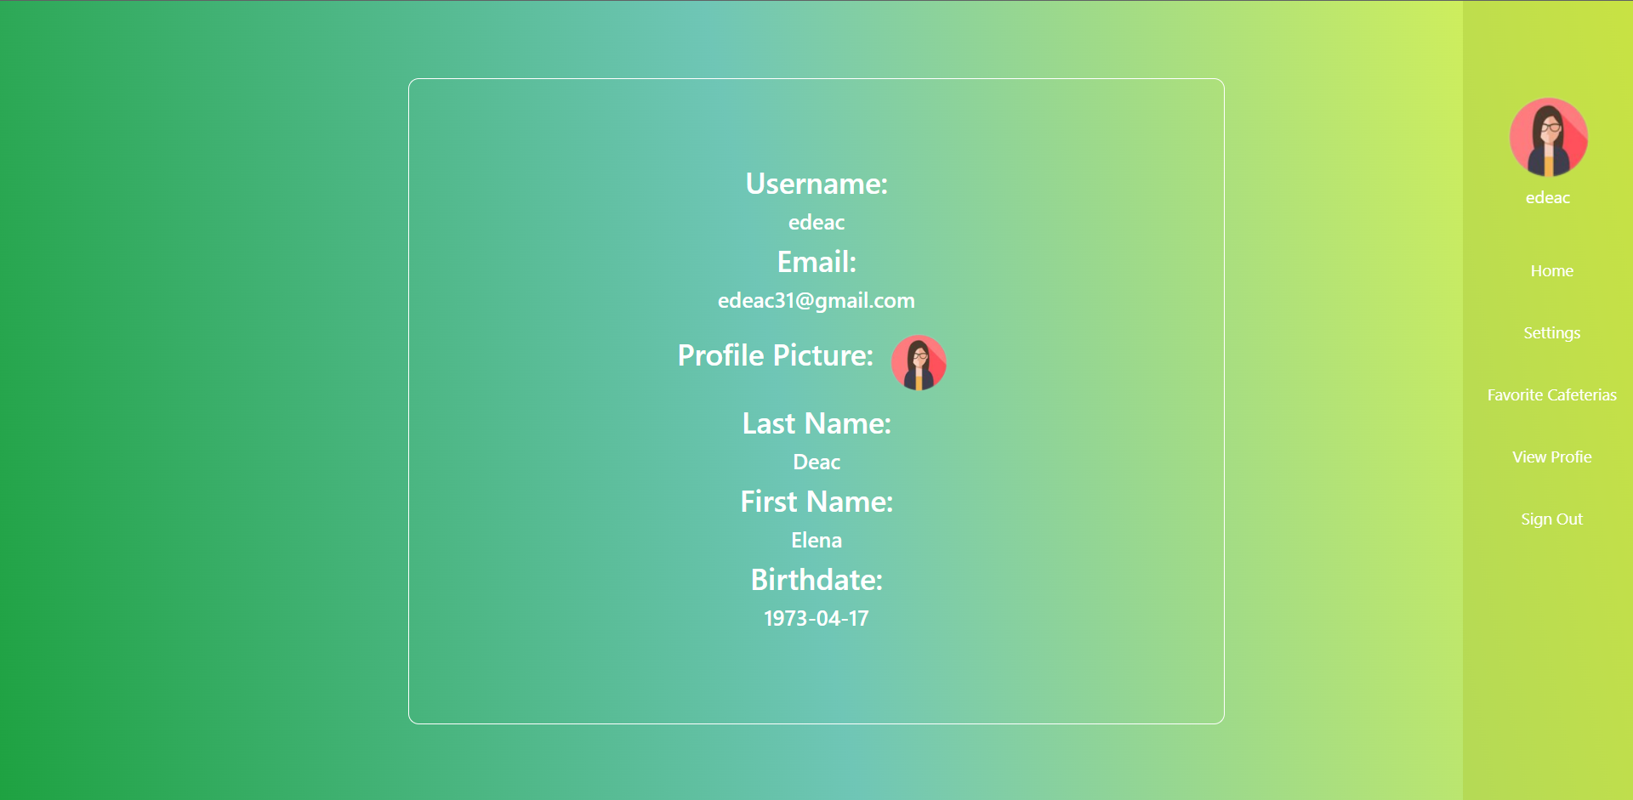
OPERATION MODE
This appears when the user wants to look at its profile.

Slide 40
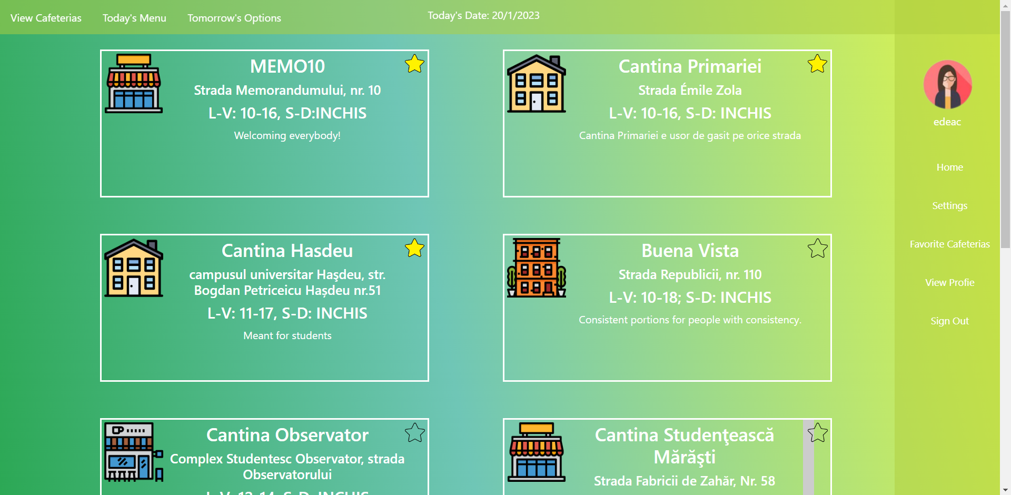
Operation mode
This is the page opening when a simple user logs in. Here are visible all the buttons brought up in the use cases description.

Slide 41
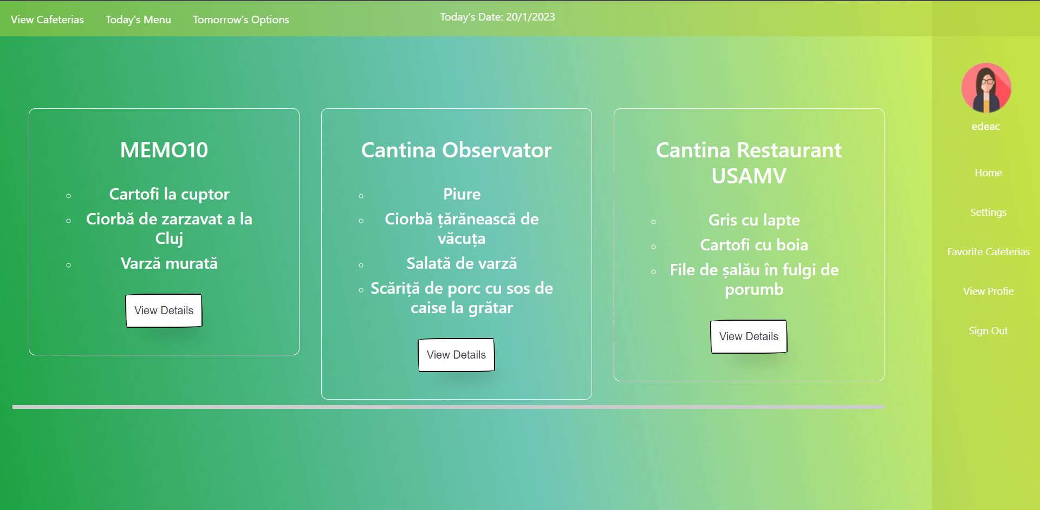
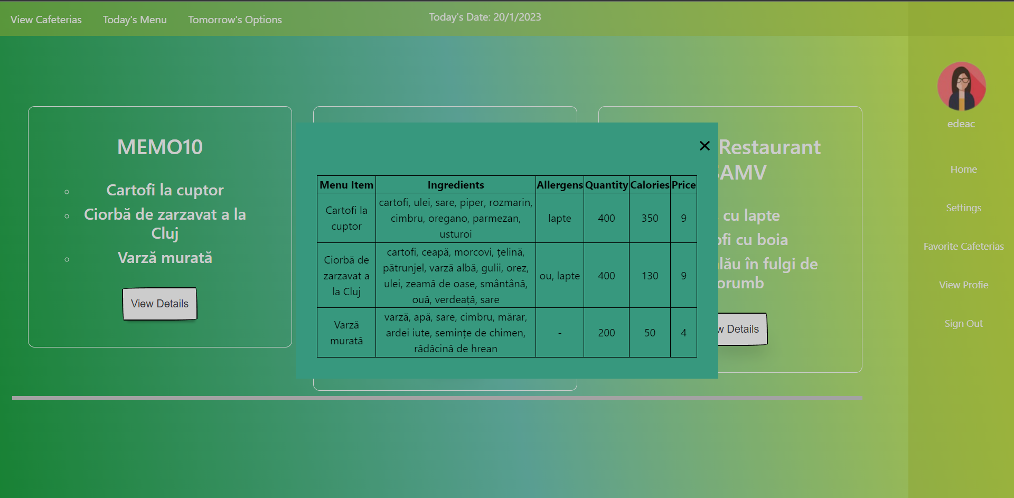
Operation mode
The simple user chooses a cafeteria and can see the menu for today.

Slide 42
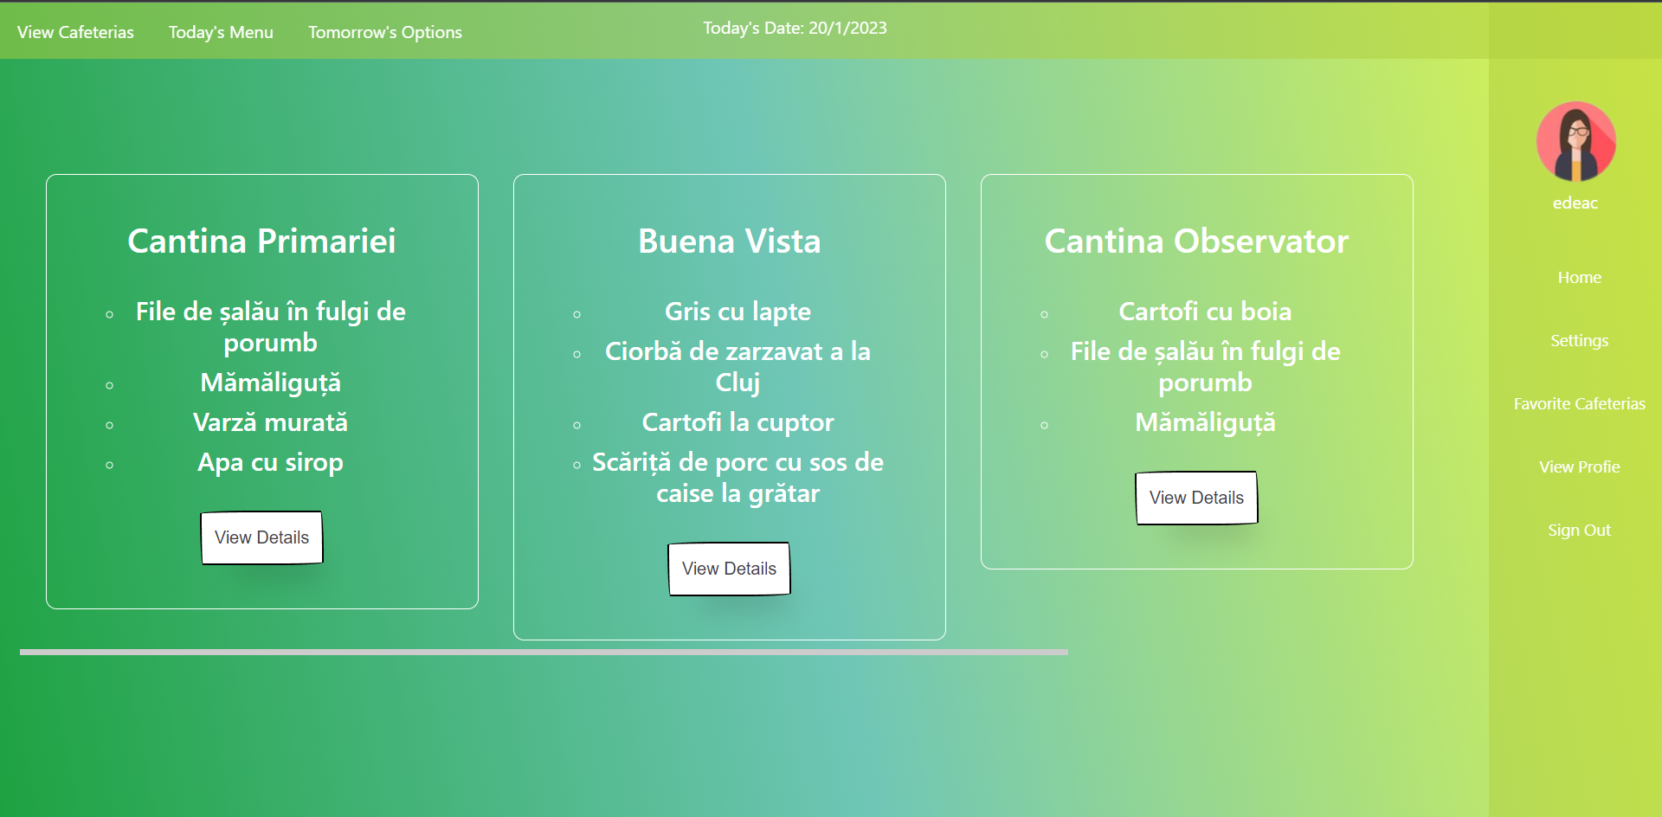
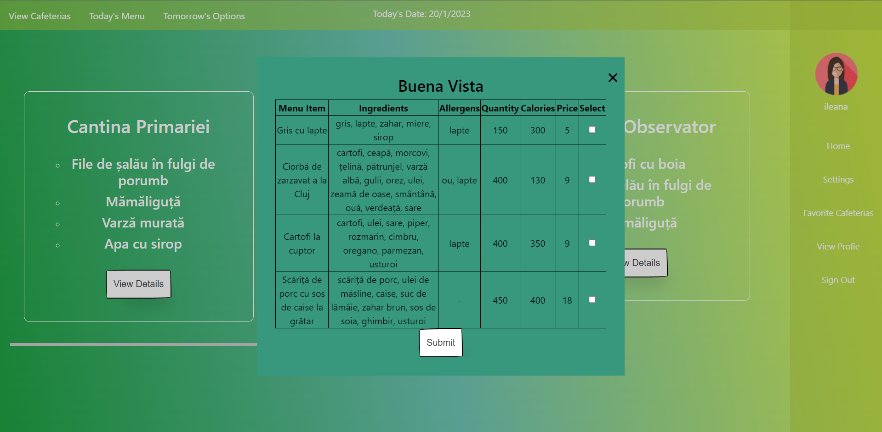
Operation mode
The simple user chooses a cafeteria and can select the desired menu items and send them to the cafeteria.

Slide 43
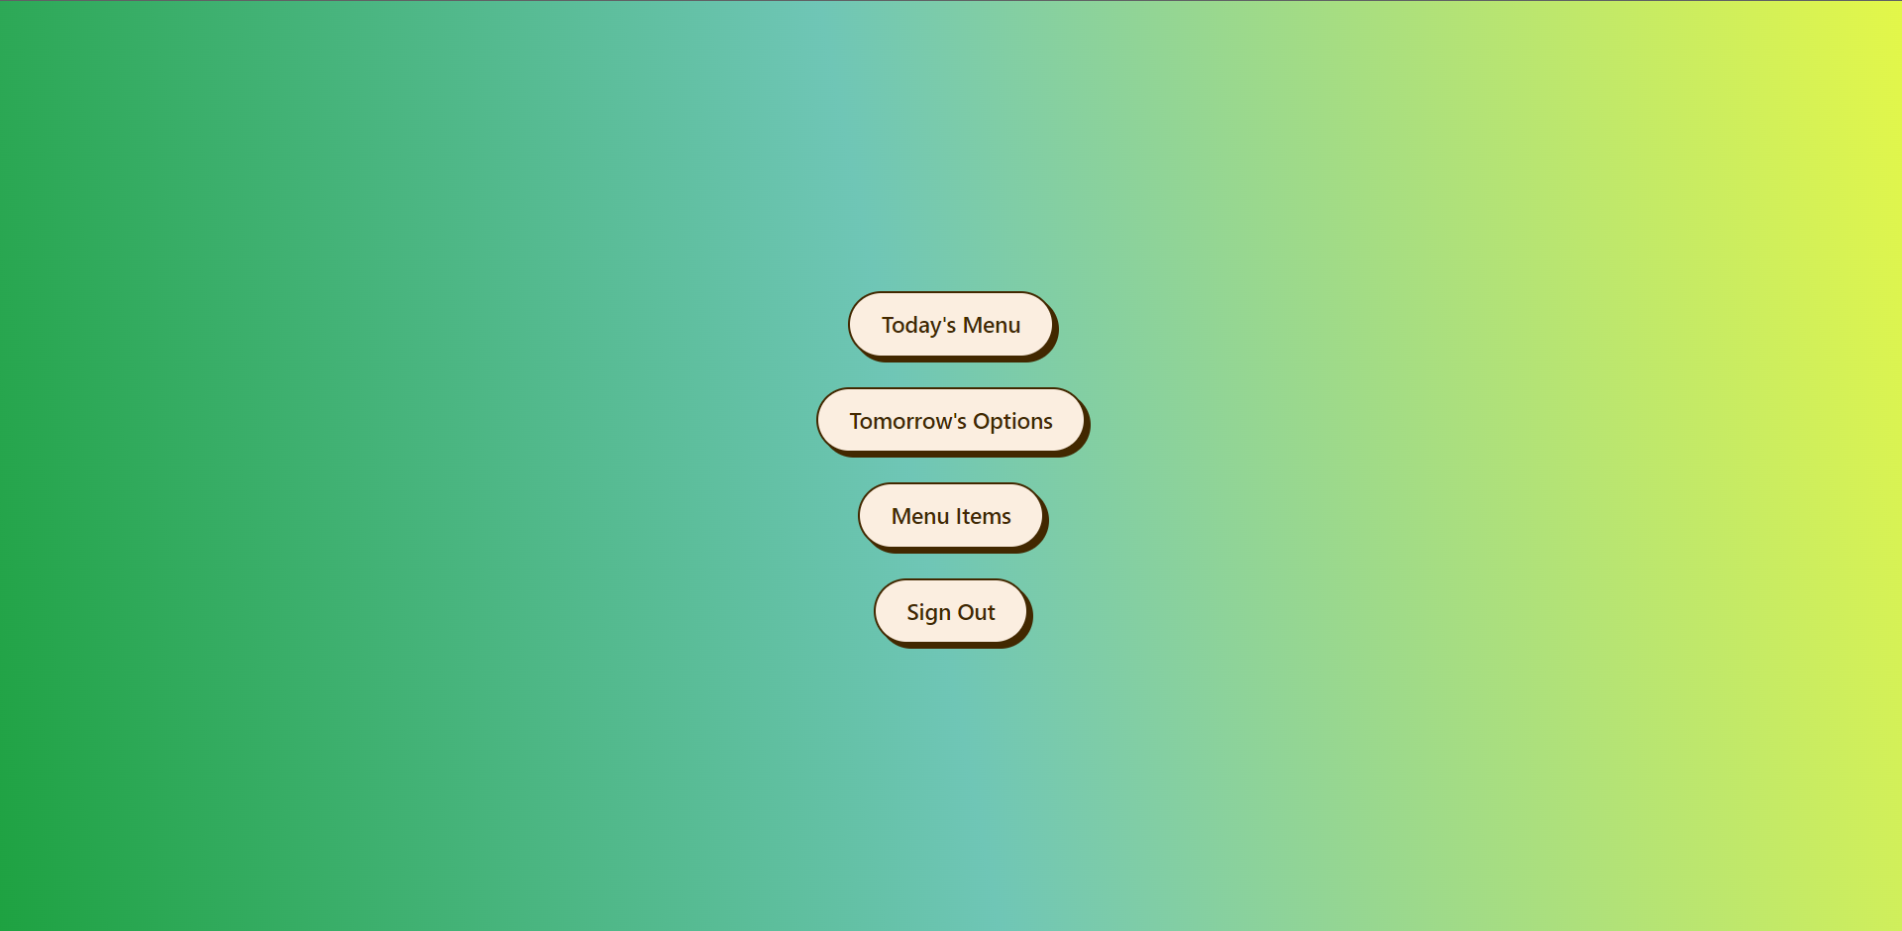
Operation mode
The opening page for a cafeteria user. From here, the user can see the statistics for today’s menu, set the options for tomorrow and manage the menu items database.

Slide 44
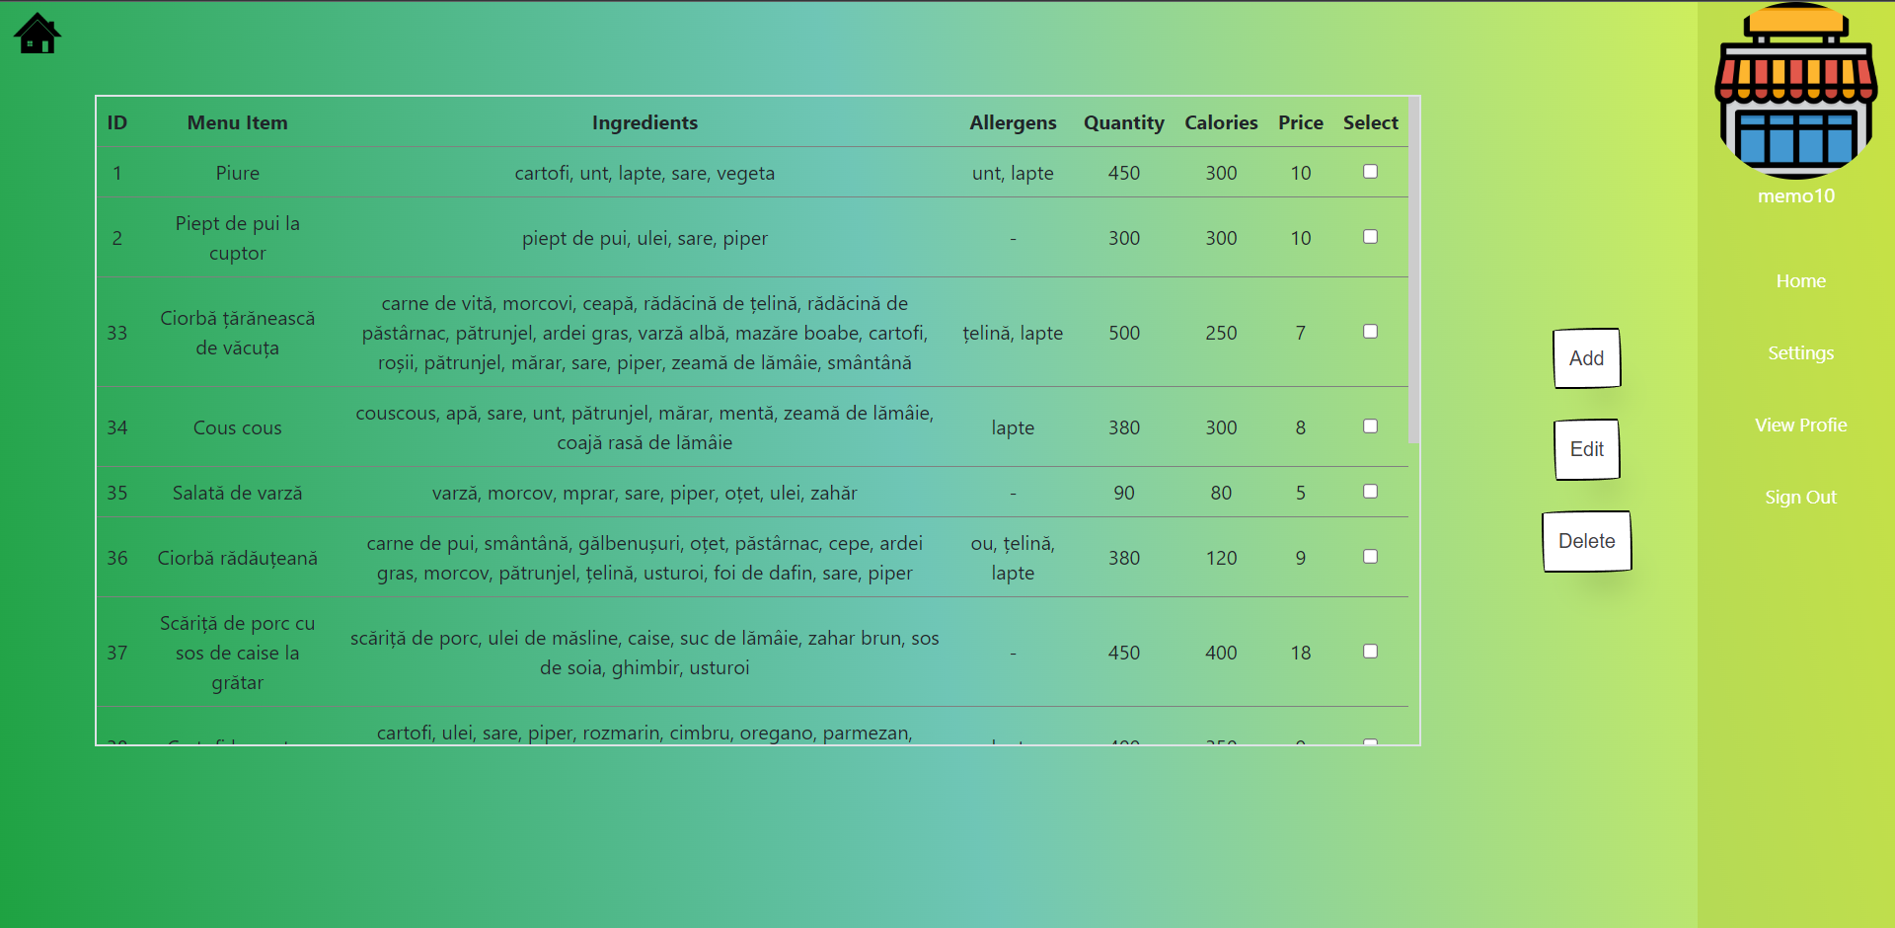
Operation mode
Here, the user can manage the menu items table in the database.

Slide 45
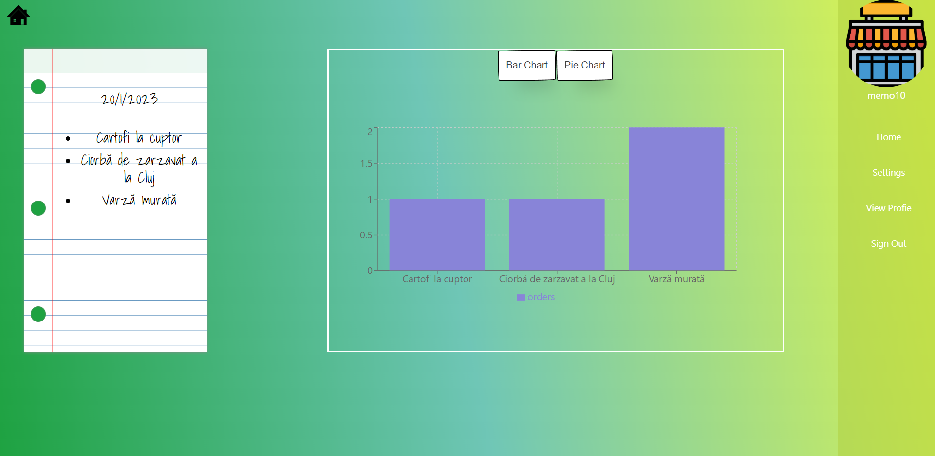
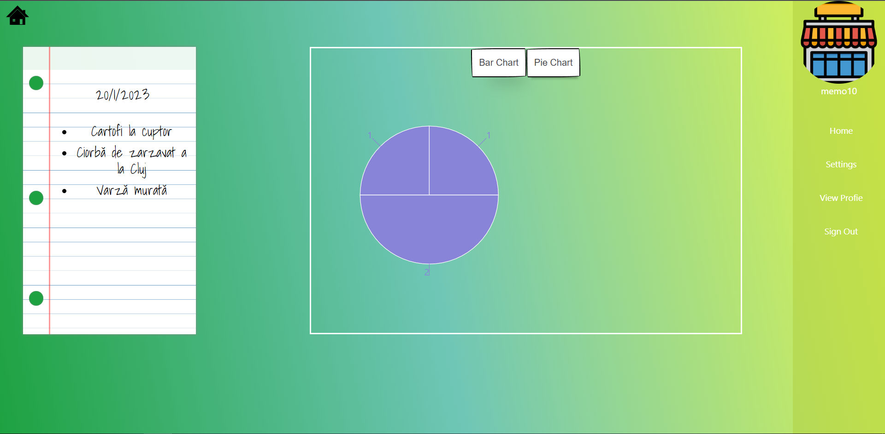
Operation mode
This is the page where the cafeteria can analyze the selections for today’s menu alongside with the statistics of selections.

Slide 46
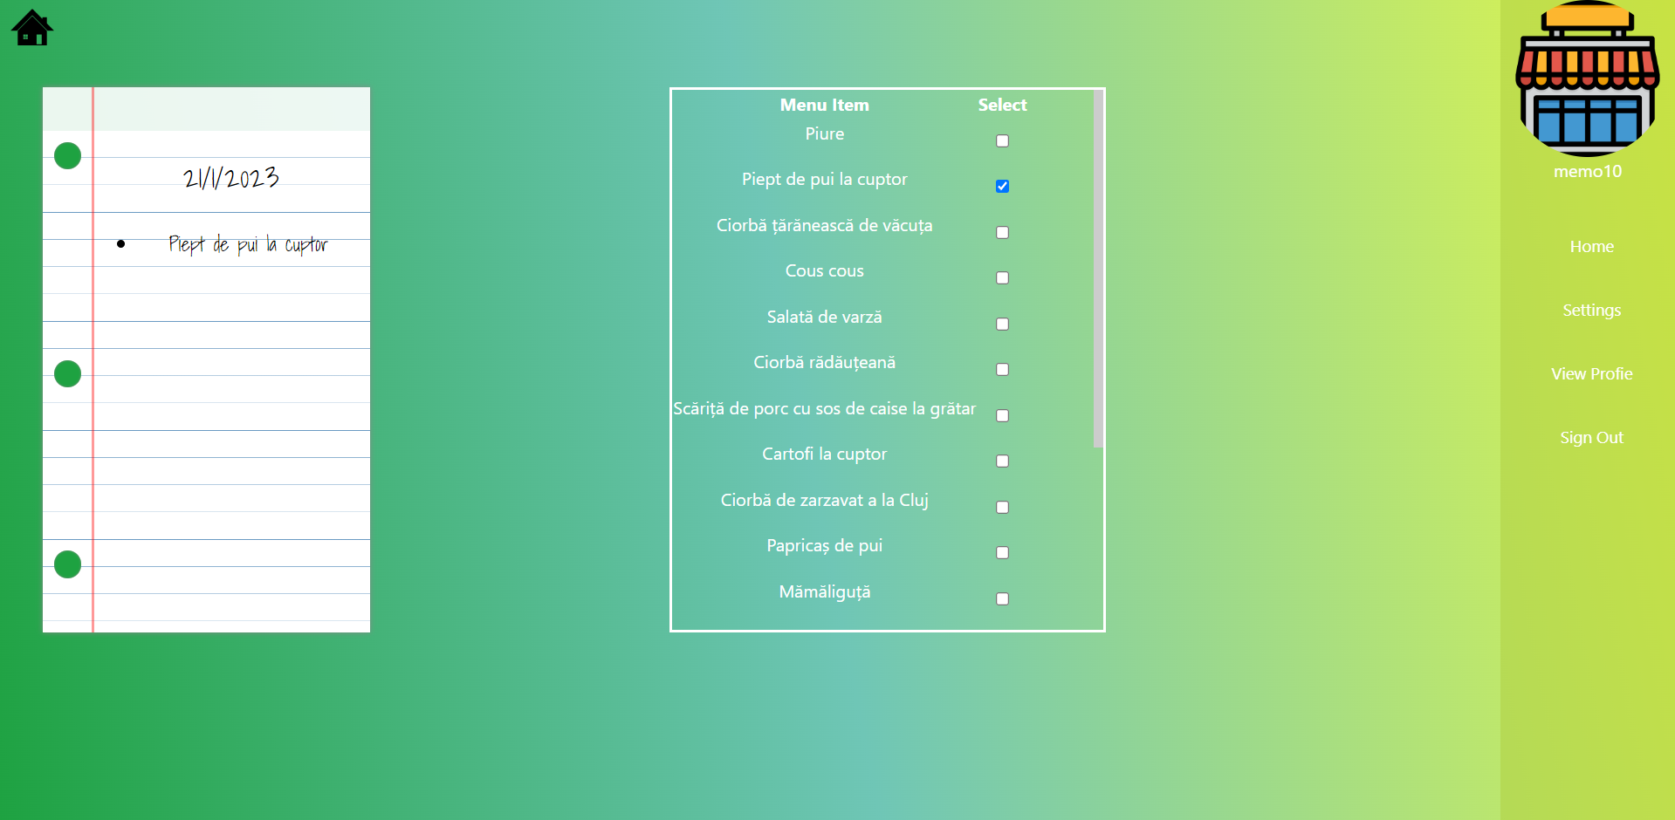
Operation mode
This is the page from where the user can select the menu items to have in tomorrow’s menu.

Slide 47
PORTABILITY
Portability is the characteristic attributed to a computer program if it can be used in an operating system other that the one in which it was created without requiring major rework. Portability of a browser is far more easily achievable than application portability, hence the decision of creating a web application.
One thing that is easier for browser portability than operating system portability is having a consistent look and feel across the platform. All browsers use CSS and generally have a consistent looking form elements (or will use the appropriate elements for the platform). With desktop applications, a cross platform native look and feel is more difficult to achieve.
And since my application is a web application (software that is accessed using a web browser), it’s portability is by default higher than that of a desktop application. I will be able to access the application from plenty of browsers and from different types of devices (all depending on the HTML and CSS code that I will write).
Browser Portability

